Slide 1

Team: Best and the Brightest
ft: Maxx Achman, Zaid Alsafi, Hristo Bonev, JessRose Narsinghia

Slide 2
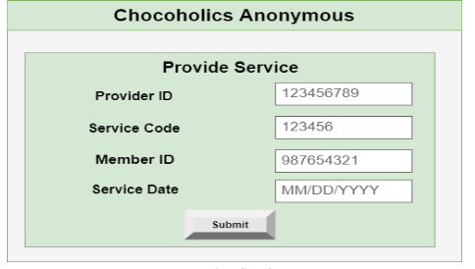
Provider GUI
The Provider GUI will be allow the user to see providers services and track when a service is given.
Provide Services
View Provider Dictionary
(check member status)

Slide 3
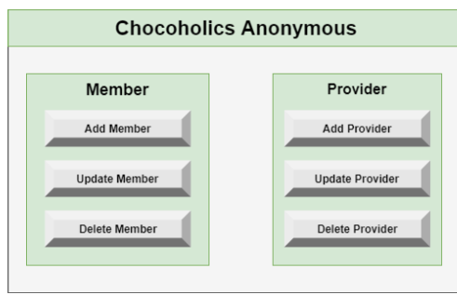
Operator GUI
Operator GUI will Manage both the Provider and Members
Adding
Deleting
Updating information

Slide 4
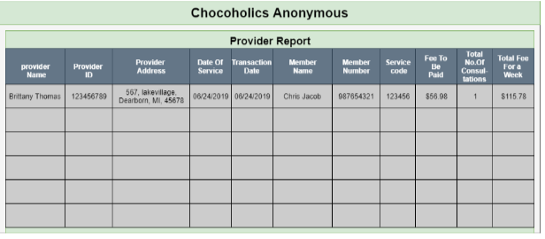
Manager GUI
The Manager GUI will give these 3 different reports
Provider Report
Summary Report
Member Report

Slide 5
Will not add in this Project
Validate payment - out of scope
Update Member status - out of scope
Transfer funds to providers - out of scope

